Slide 1
Demysify
Anubis Bankbot

Slide 2
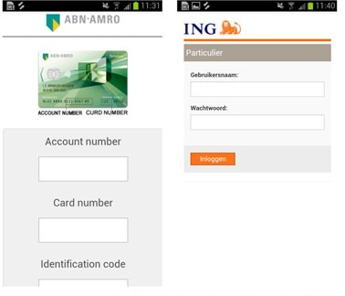
Bankbot
Masquerades as a benign app (similar icon and name)
Ask for administrative privileges
Monitor processes
Compare process names against the targeting banking apps
Create an overlay window
Trick users to put down credentials
Send data to the server

Slide 3
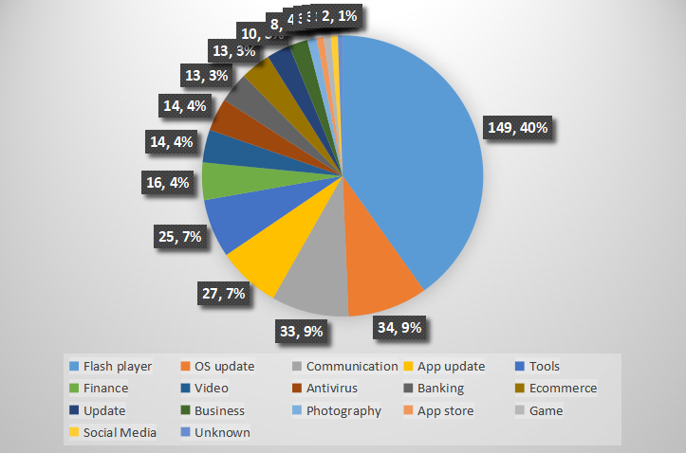
Anubis

Slide 4
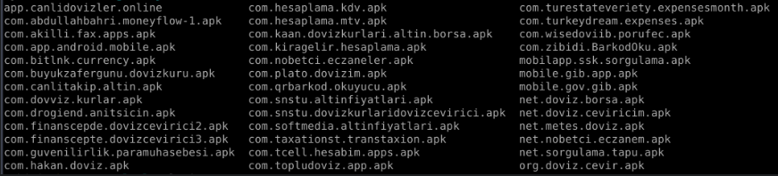
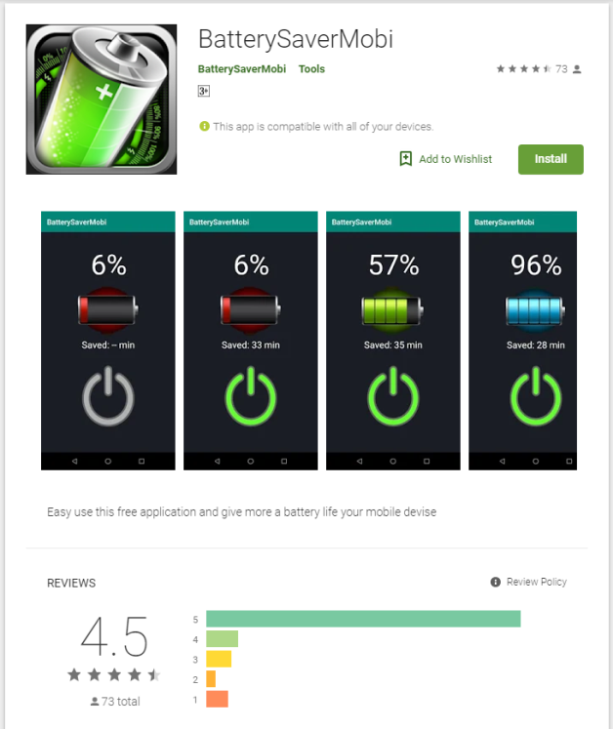
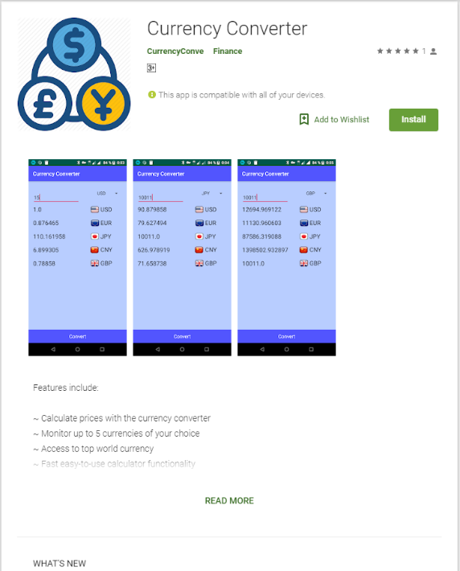
Anubis
Package name

Slide 5
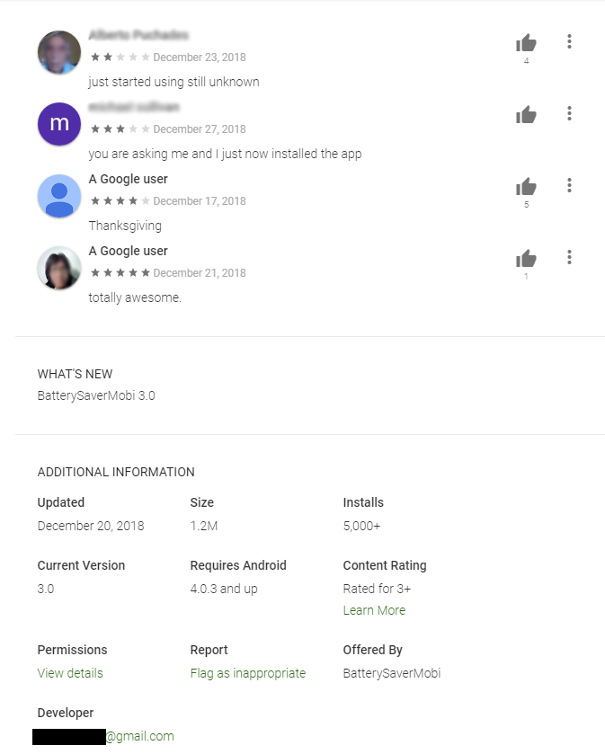

Slide 6
Anubis
Capabilities
Steal information with overlay attacks
Ransomware
SMS interception
Call forwarding
RAT (Remote Access Trojan)
Keylogger

Slide 7
Anubis
Spread
Anubis
Downloader
Payload

Slide 8
Anubis
Spread
via Third Party
Anubis
Payload

Slide 9
Anubis
Spread
via Google Play
Anubis
Downloader
REQUEST_INSTALL_PACKAGES
Payload

Slide 10
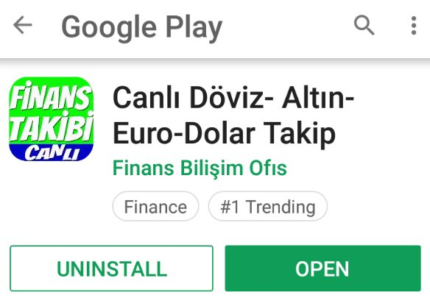
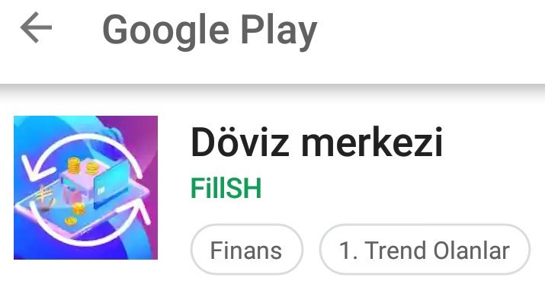
Anubis
Social
Engineering
Disguise
Currency-Gold-Euro
Currency Center

Slide 11
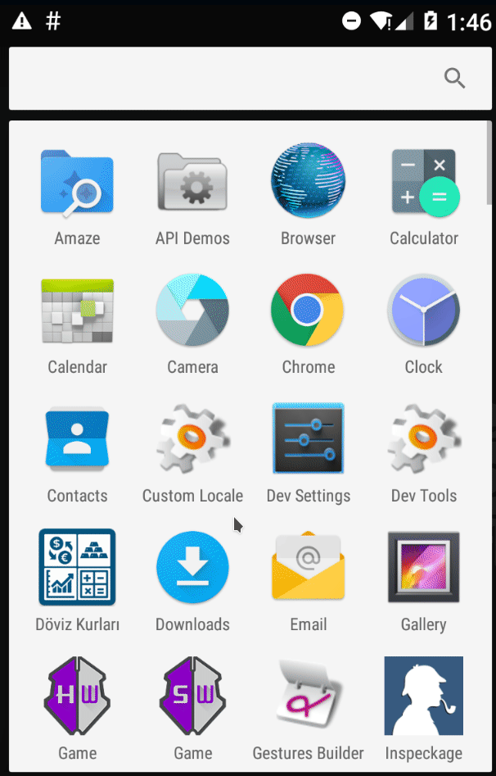
First stage
Downloader installed
Prompt “App needs to be updated” when open
Forward to the real legitimate app at Google Play Store
The real legitimate app installed
Remove the icon of Downloader from homescreen(only the legitimate app left)
However, 2 in application list !

Slide 12
Second stage
Payload downloaded from C&C
prompt for activating third-party installation
Payload app installed
Ask for permissions when opening
Payload app disappears from homescreen

Slide 13





Second stage
Icons of downloaded app could be:
Flash Player Update
Update
Operator Update
Service Update
System Update

Slide 14
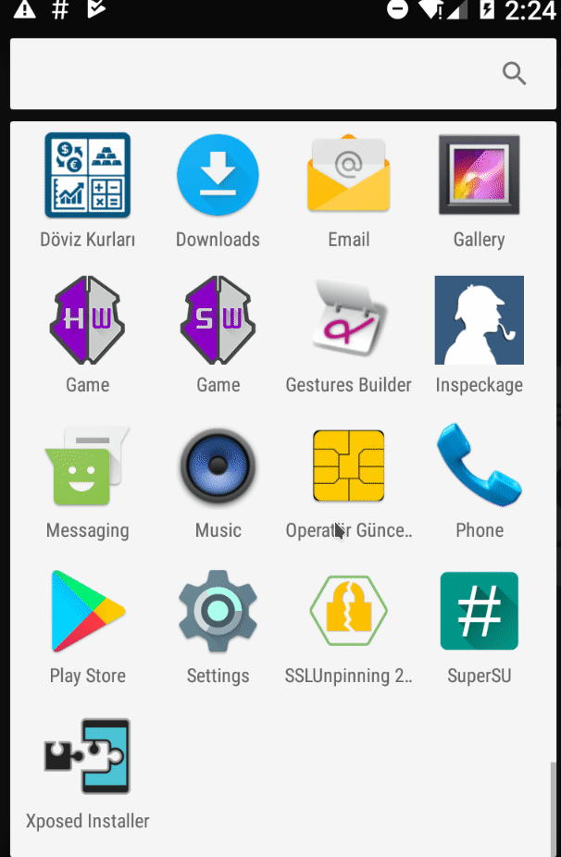
Second stage

Slide 15
Persistence
Recieve_boot_completed
'Allows an application to receive the Intent.ACTION_BOOT_COMPLETED that is broadcast after the system finishes booting'
--- official Google android developer website
Want to delete from app list ?
prompt “System apps cannot be deleted” when clicking the app icon in settings
user forwarded to homescreen

Slide 16
Accessibility
'Accessibility Services run in the background and receive callbacks by the system when AccessibilityEvents are fired. Such events denote some state transition in the user interface, for example, the focus has changed, a button has been clicked, etc. Such a service can optionally request the capability for querying the content of the active window' --- Google Android developer website
Anubis check 4 types:
TYPE_VIEW_CLICKED
TYPE_VIEW_FOCUSED
TYPE_VIEW_TEXT_CHANGED
TYPE_WINDOW_STATE_CHANGED

Slide 17
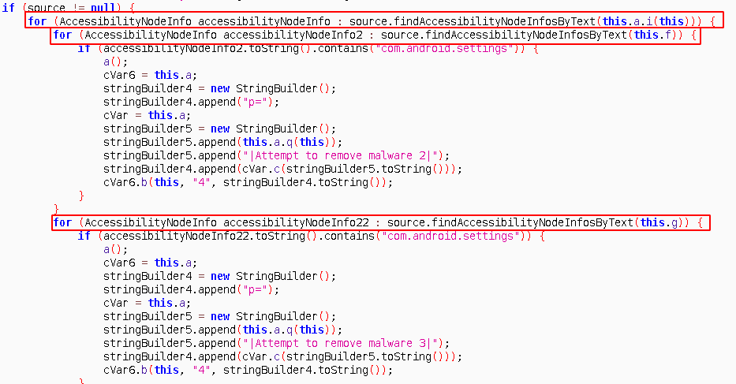
Undeletable
TYPE_WINDOW_STATE_CHANGED ?
event triggered by com.android.settings ?
Click the payload app (this.a.i(this))?
Uninstall (this.f) or to remove (this.g) ?

Slide 18
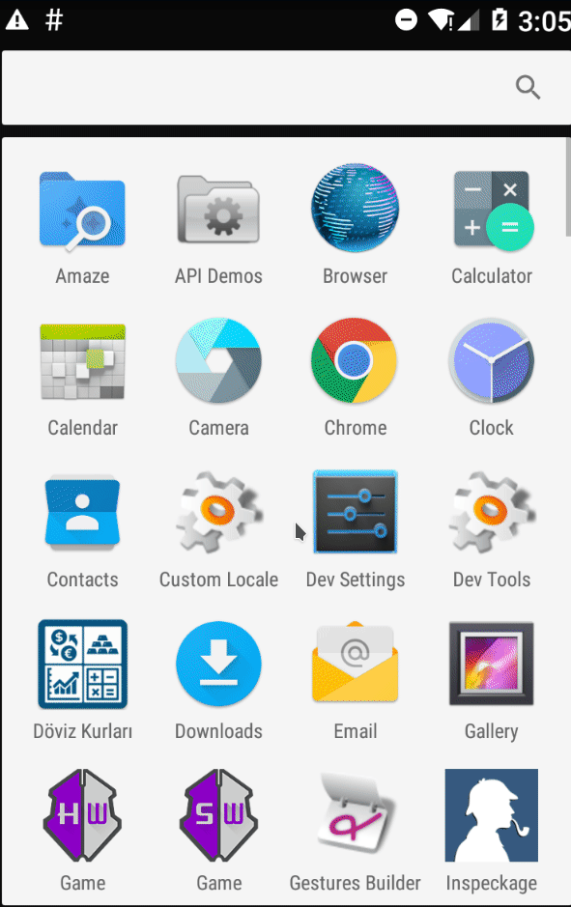
If all true:
activity(a()) is triggered
(Open AlertDialog with 'System apps cannot be deleted')

Slide 19
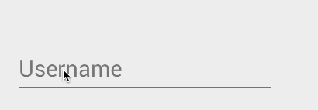
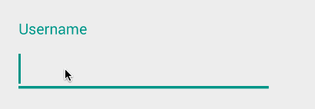
Keylogger
TYPE_VIEW_CLICKED
TYPE_VIEW_FOCUSED
TYPE_VIEW_TEXT_CHANGED

Slide 20
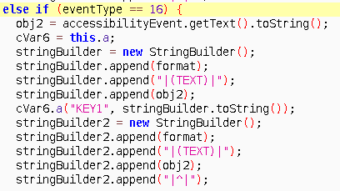
Keylogger
EventType 16 : TYPE_VIEW_TEXT_CHANGED
obj2 = accessibilityEvent.getText().toString() \\ Get changed text (and then send back to server)

Slide 21
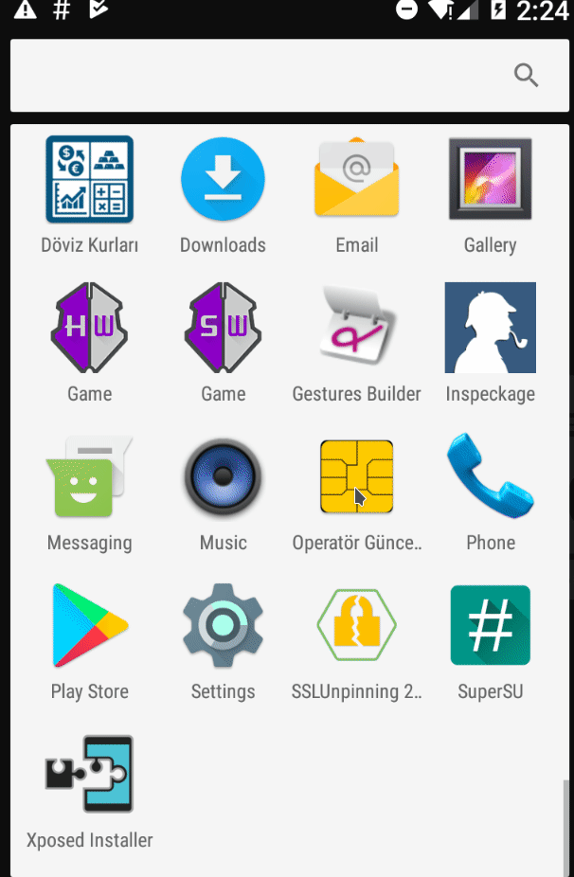
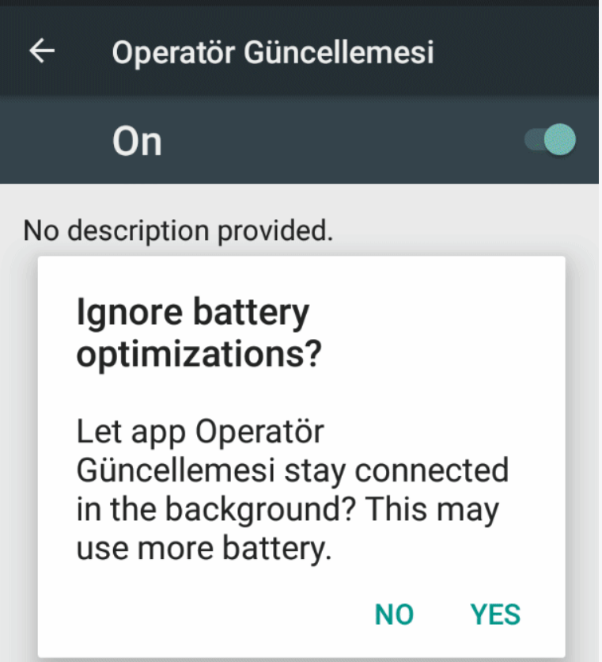

Slide 22
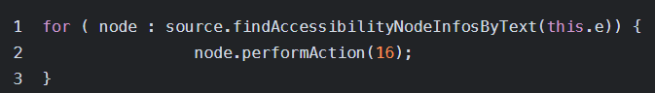
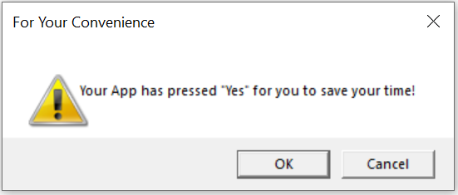
What's happening
action 16 : ACTION_CLICK
this.e : StringYes
Accessibility

Slide 23
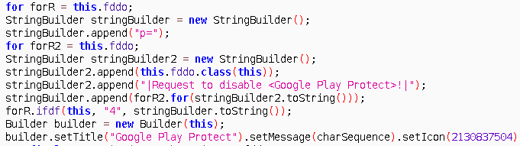
Disarm Play Protect

Slide 24
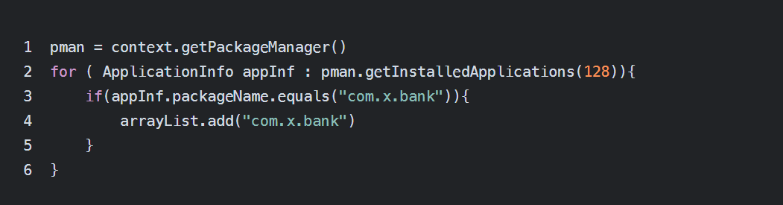
Acquire Package List
com.x.bank ?

Slide 25
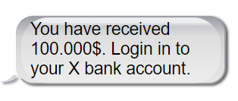
Plan B
Accurate Fake SMS
Fake overlay !

Slide 26
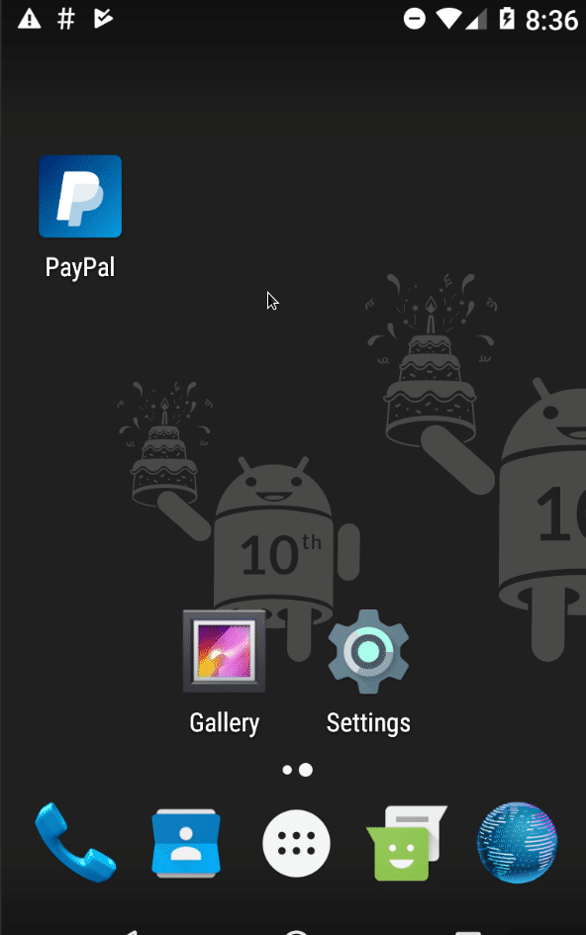
Overlay Attack
Backtracked to early 2016 (MazarBot) [1]
Collect users’ private data
As soon as targeted app [2] is opened:
Malware Triggered
Pull specific phishing page from C&C
Overlay over targeted banking app

Slide 27
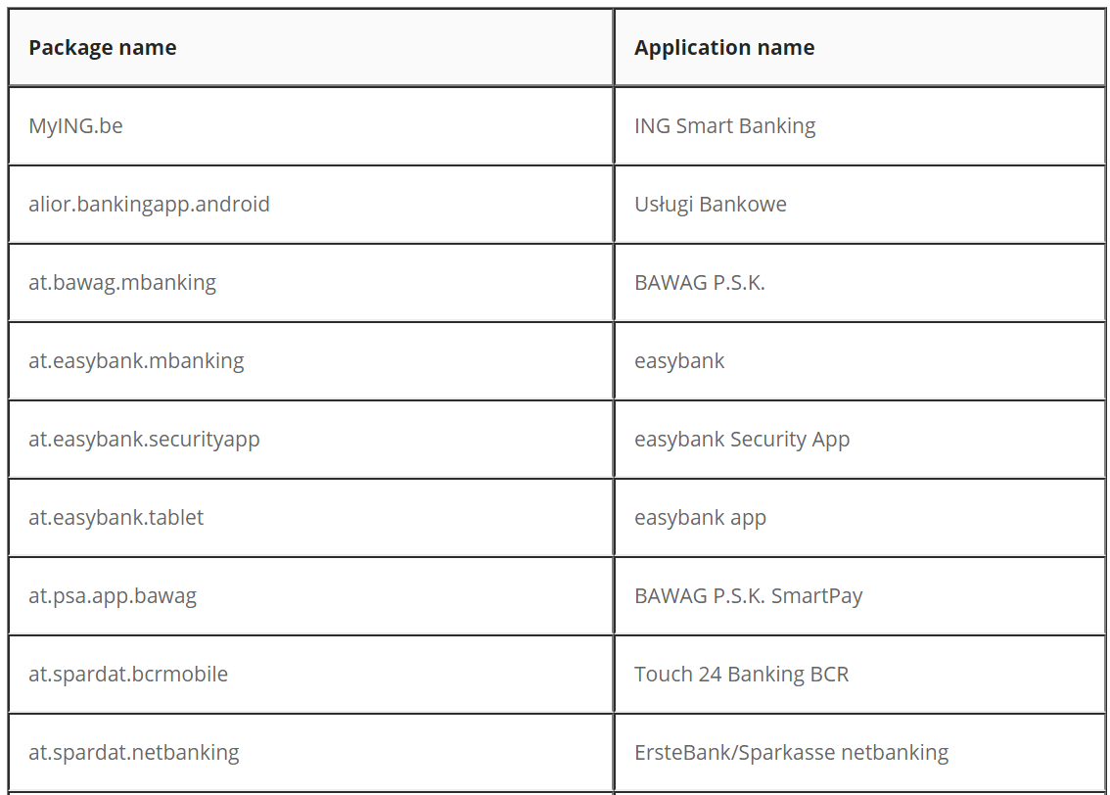
Targeted App List (Some)
…

Slide 28
Process Scanning
How malware detect opened apps & overlay itself?
While(true)
</uses-permission>
<uses-permission
name=‘android.permission.PACKAGE_USAGE_STATS’>
GET TOP Process/Package name

Slide 29
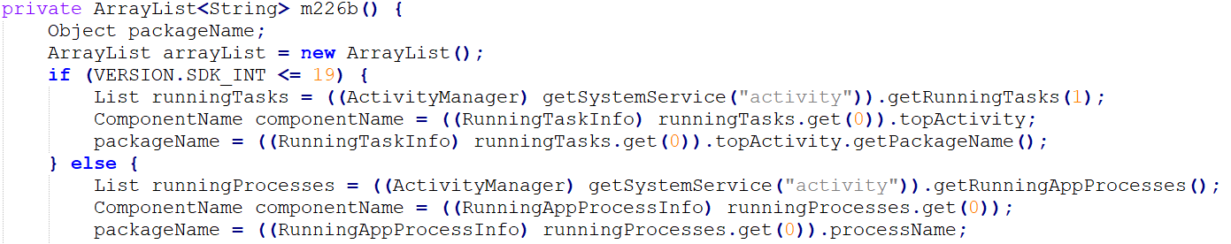
Compare with
targeted app names

Slide 30
MATCH?
Y
Fetch corresponding PHP file from C&C

Slide 31
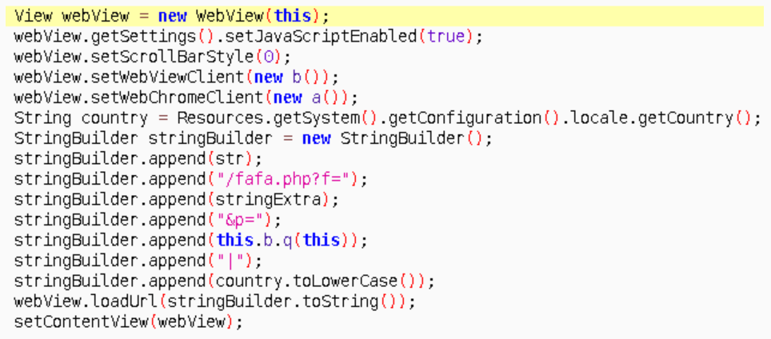
OPEN UP THROUGH webView
(doesn’t need permission)

Slide 32

Battery Issues?
Life Without
REQUEST_IGNORE_BATTERY_OPTIMIZATIONS
Battery opt apps
Malware
MISSION FAILED！

Slide 33
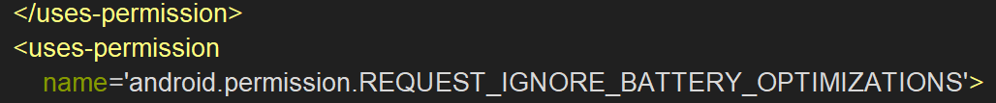

Battery Issues?
Life With
REQUEST_IGNORE_BATTERY_OPTIMIZATIONS
Battery opt apps
Malware
MISSION ACCOMPLISHED！

Slide 34
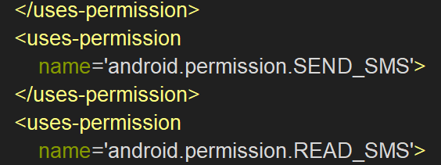
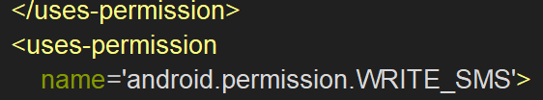
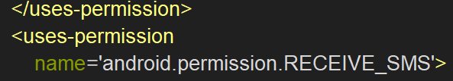
Ultimate #1: SMS Interception

Slide 35
Request for being the default SMS app
Receive, Read,Write & Send OTP codes
Delete the SMS

Slide 36
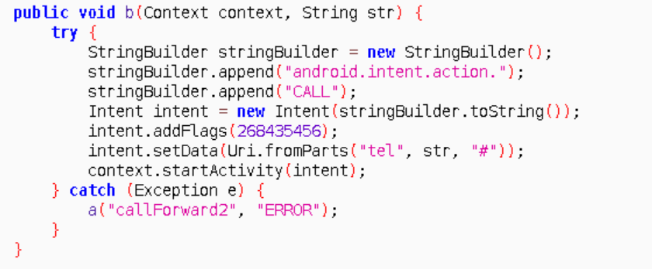
Ultimate #2: Call Forwarding
Calls
from bank
Malware
Author

Slide 37
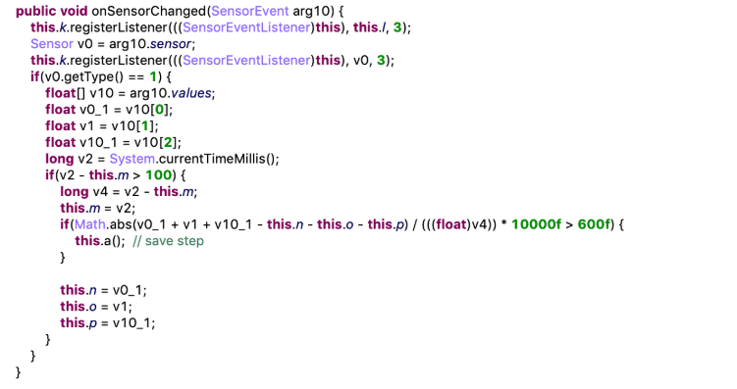
Ultimate 3: Sandbox-evading

Slide 38
Ultimate 3: Sandbox-evading
RegisterListener :
public boolean
registerListener (SensorEventListener listener, Sensor sensor, int samplingPeriodUs )
Sampling PeriodUs | Constant Value | Constant | Time indicated
 | 0 | SENSOR_DELAY_FASTEST | 0 ms
 | 1 | SENSOR_DELAY_GAME | 20 ms
 | 2 | SENSOR_DELAY_UI | 60 ms
 | 3 | SENSOR_DELAY_NORMAL | 200 ms

Slide 39
Ultimate 3: Sandbox-evading

Slide 40
Ultimate 3: Sandbox-evading
V0 == Sensor.TYPE_ACCELEROMETER
V10[0]: Acceleration minus Gx on the x-axis
V10[1]: Acceleration minus Gy on the y-axis
V10[2]: Acceleration minus Gz on the z-axis
in SI units (m/s^2)

Slide 41
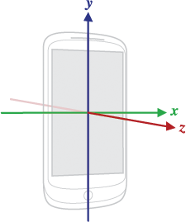
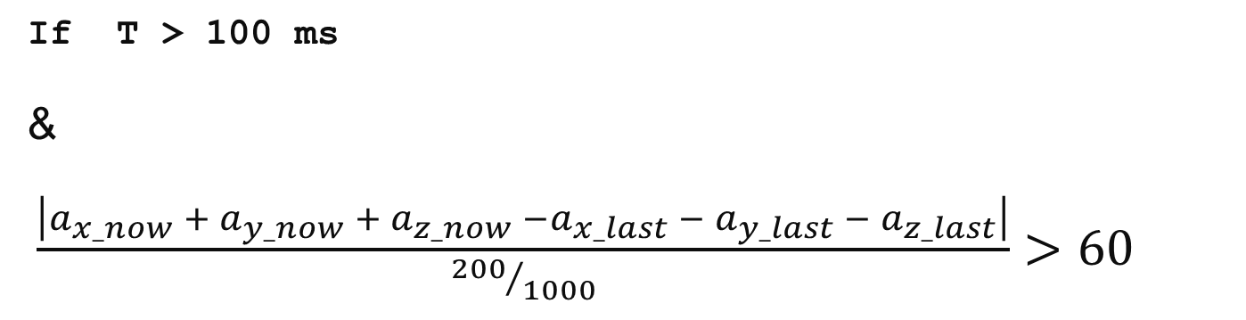
If T > 100 ms
&
$\frac{\left|a_{x_now} + a_{y_now} + a_{z_now} −a_{x_last} − a_{y_last} − a_{z_last}\right|}{{200}/{1000}}>60$
$\left|a_{x_now} + a_{y_now} + a_{z_now} −a_{x_last} − a_{y_last} − a_{z_last}\right|$ > 12

Slide 42
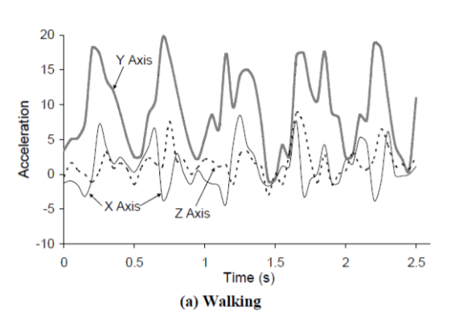
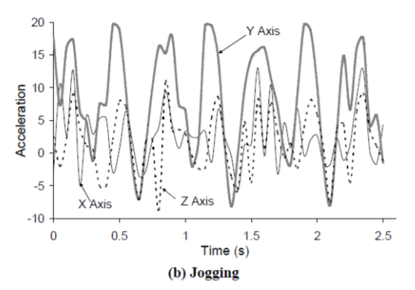
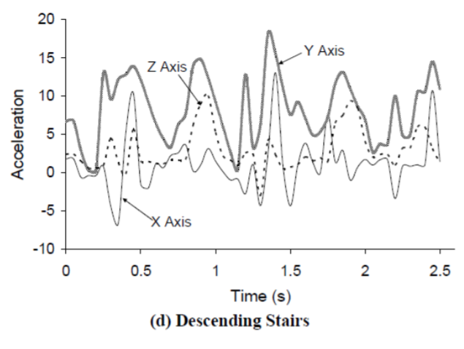
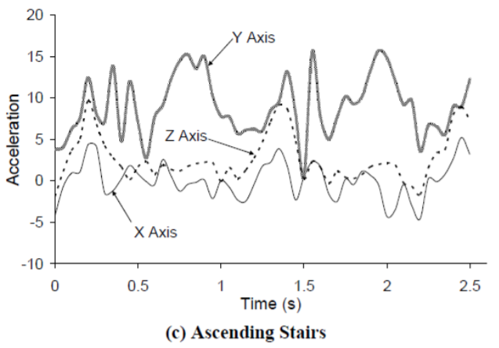

Slide 43
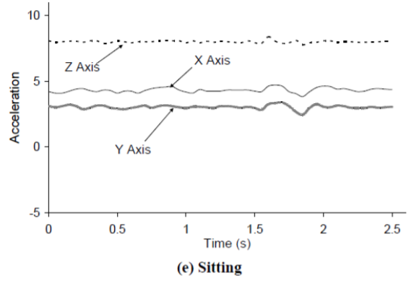
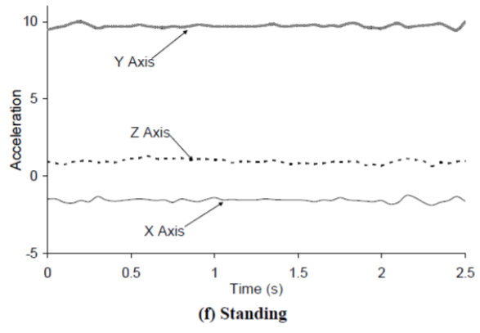
Source:
Worcester Polytechnic Institute, CS 528 Lecture 6b
http://web.cs.wpi.edu/~emmanuel/courses/cs528/F17/slides/lecture06b.pdf

Slide 44
Real Life
Real Life
Status | Matching Frequency
Walking | Usually
Jogging | Always
Ascending Stairs | Sometimes
Descending Stairs | Sometimes
Sitting | Never
Standing | Never

Slide 45
Sandbox?
No sensor data
0% NEVER

Slide 46
Reference:
[1] Android MazarBot stealing credit card information in Italy with certified issued by Putin, https://lukasstefanko.com/2016/02/android-mazarbot-stealing-credit-card-information-in-italy-with-certified-issued-by-putin.html
[2] Anubis II - malware and afterlife, https://www.threatfabric.com/blogs/anubis_2_malware_and_afterlife.html

Slide 47
Q & A

